Slide 1


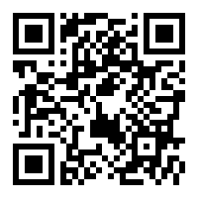



CE IoT CHALLENGE 2021 Training
Download training documents at:
bom.to/CEIoT21_TrainingDocs
Nguyen Manh Thao

Slide 2
Workshop Contents
A brief review on LoRa/LoRaWAN
RFThings Design KIT (DK)
RFThings NewUCA
ESP LoRaWAN Single Channel
Q & A

Slide 3
A brief review on LoRa/LoRaWAN

Slide 4

RFThings Design KIT (DK)

Slide 5
RFThings NewUCA

Slide 6
ESP LoRaWAN Single Channel

Slide 7
Q & A

